Slide 1
THESIS BRIEFING
MASTER OF INFORMATICS BATCH 2024

Slide 2
STUDENT MUST DECIDE..
THESIS TOPIC
THESIS ADVISOR

Slide 3
WHO CAN BE YOUR THESIS ADVISOR
Dr. Adhi Setyo Santoso, S.T., M.BA.
MIS
Digital Convergence
Data Science
Prof. Dr. Ir. Wiranto Herry Utomo, M.Kom.
Big Data Analytics
Data science
Service Oriented Architecture
Ahmad Fadhil N, Ph.D
Deep Learning
Natural Language Processing
Game Development
Dr. Hasanul Fahmi, S.Kom., M.Kom.
Deep Learning
Machine Learning
Information Retrieval

Slide 4
WHO CAN BE YOUR THESIS ADVISOR
Ir. Rusdianto Roestam, M.Sc., Ph.D.
Internet of Things
Machine Learning
Cyber Security
Ubiq Computing
Dr. Tjong Wan Sen, S.T, M.T.
Voice Image Recognition
Computer Vision
Deep Learning
Dr. Deffa Rahadiyan, S.Si.
Artificial Intelligence
Natural Language Processing
Computer Vision

Slide 5
WHAT SHOULD YOU DO TO GET THESIS ADVISOR
Please prepare your thesis topic and your option of the advisor
Please send your topic and advisor option to: https://forms.gle/1GQBwYwT3yvjXwT3A
Please list 7 your advisor option on your request like:
Advisor 1 : Mr/Mrs…..
Advisor 2 : Mr/Mrs…..
Advisor 3 : Mr/Mrs…..
Advisor 4 : Mr/Mrs…..
Advisor 5 : Mr/Mrs…..
Advisor 6 : Mr/Mrs…..
Advisor 7 : Mr/Mrs…..
Study program will do consideration about the final result of your thesis advisor and will announce the result in the first day semester starts.

Slide 6
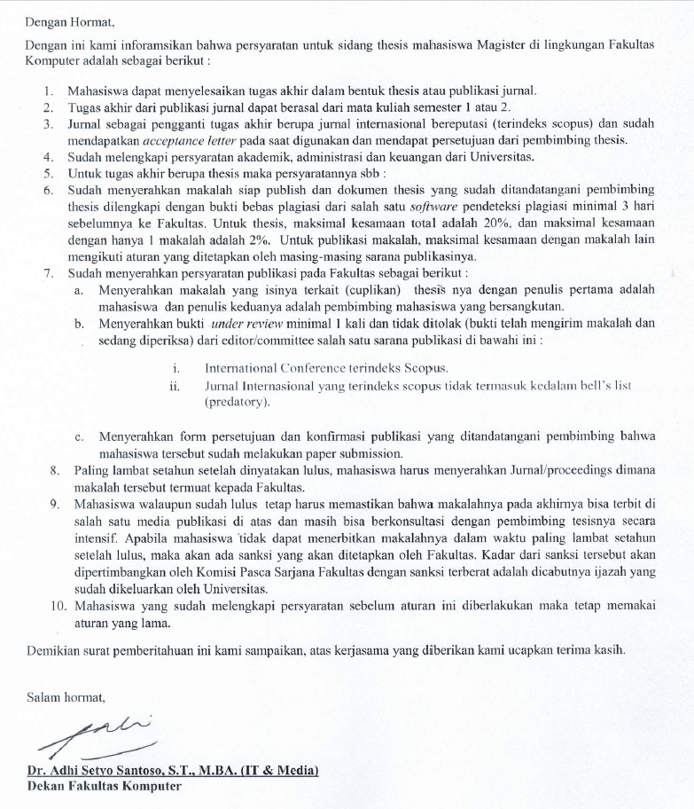
THE REQUIREMENTS OF THESIS DEFENSE IN FACULTY OF COMPUTING
According to IOM with number of letter 005/FC-MIT/PU/VIII/2024

Slide 7
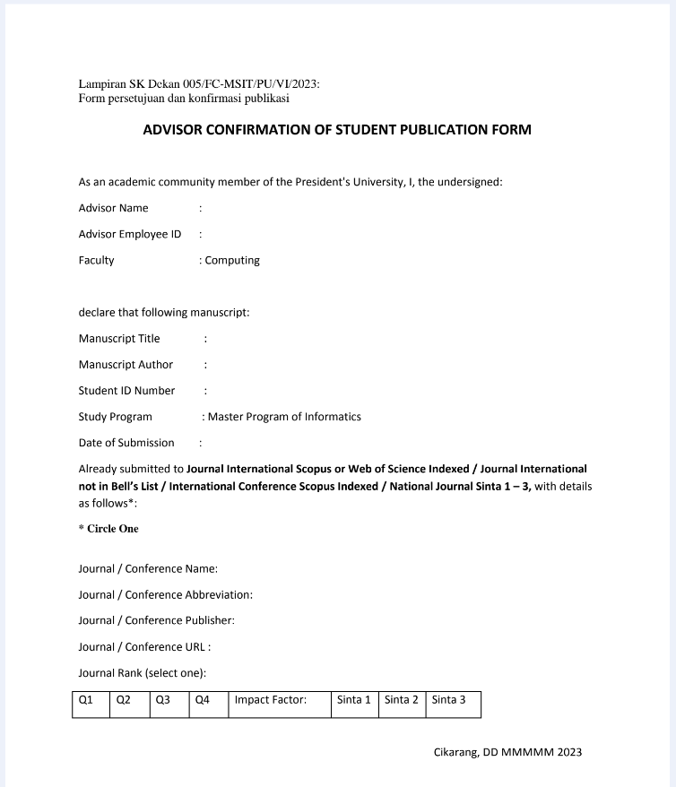
THE REQUIREMENTS OF THESIS DEFENSE IN FACULTY OF COMPUTING
This form you will get from faculty admin with the IOM of thesis defense requirements and thesis writing guidelines
According to IOM with number of letter 005/FC-MSIT/PU/VI/2023

Slide 8
WHAT SHOULD YOU MAKE SURE/PREPARE DURING WRITING THESIS
ENGLISH PROFICIENCY
According to Peraturan Rektor Nomor 21 Tahun 2023
*attached

Slide 9
WHAT SHOULD YOU DO TO REGISTER PROPOSAL DEFENSE
THE REQUIREMENTS TO REGISTER OF PROPOSAL DEFENSE
Please make sure you got approval from your thesis advisor to do proposal defense
After you got approval from advisor, please pay the fee of proposal defense = Rp 2.200.000,00
Send your payment proof to finance (finance@president.ac.id) and wait until you got the response/approval from finance to do proposal defense
Please send these to your thesis advisor email and faculty staff (nadella@president.ac.id) :
Draft
Finance approval of proposal defense fee

Slide 10
WHAT SHOULD YOU DO TO REGISTER FINAL DEFENSE
THE REQUIREMENTS TO REGISTER OF FINAL DEFENSE
Please make sure you got approval from your thesis advisor to do final defense
Please request the clearance in PUIS - Clearance - Thesis/Final Project Defense
After you requested, please pay the fee of final defense = Rp 3.500.000,00
Make sure all division in clearance already validate it
Please send these to your thesis advisor email and faculty staff (nadella@president.ac.id) :
Draft
Clearance
Turnitin (max 20%)
Validated consultation sheet in PUIS (min 8 times)
Under review journal proof
Journal Submission Form

Slide 11
WHAT SHOULD YOU DO AFTER FINAL DEFENSE
Do you revision, usually 2 weeks for minor revision and 1 month for major revision (you will get the list of revision from faculty staff by email after defense)
Send your revision to examiner, advisor, cc faculty staff (nadella@president.ac.id) by email
After you got approval from examiner and advisor, please come to faculty to get all lecturer sign (no digital signature)
Please ask admin of study program signature on your signed panel of examiner
After you got signature from lecturer, please make a CD for faculty repository and submit your thesis to PUIS (the detail will you get in the correction file after do final defense)
After you submit your thesis in PUIS, please give your hardcopy of signed panel of examiner to library and ask the validation to library staff or by library.clearance@president.ac.id
After you got the score of your thesis (completed point no 1-6) and passed english proficiency, please do yudicium clearance and graduation enrollment

Slide 12
THESIS TIMELINE BATCH 2024-1
Advisor Request : May 30, 2025
Advisor Announcement : June 9, 2025
Proposal Defense : July 14, 2025 (tentative)
Final Thesis Submission : August 15, 2025 (tentative)
Final Thesis Defense : August 18, 2025 (tentative)
Grading : August 26, 2025
*please follow the timeline of Proposal Defense - Grading to make sure you doesn’t need to extend the thesis

Slide 13
SUMMARY
Please start to consider your thesis advisor with prepare the topic and your advisor option and fill the gform what study program given to you.
The maximum deadline for choosing advisor is 30 May 2025. Study program will start announce who your thesis advisor in the first day of semester 20243 starts and you can start do consultation with your advisor.
The new regulation to do final defense is you should give us a proof of your under review of your journal. The publisher should be index by scopus
Make sure you already passed the english proficiency test ASAP for yudicium clearance requirements.
The timeline written tentative become your standard to do every step to make sure your thesis finish on time

Slide 14
GOOD LUCK AND SEE YOU IN GRADUATION
*if you have another question related thesis - graduation administration, please contact faculty staff:
Nadella = 087779147996 / nadella@president.ac.id

